Slide 1


          University of Diyala
          College of Engineering
          Department of Electronics Engineering
Course Number: U103
Course Name: Computer Networks
Lecture (6)
Asst. Lect. Ahmed Mohammed Ahmed

Slide 2
Switching
6-1 Introduction
A network is a set of connected devices. Whenever we have multiple devices, we have the problem of how to connect them to make one-to-one communication possible. One solution is to make a point-to-point connection between each pair of devices (a mesh topology) or between a central device and every other device (a star topology). These methods, however, are impractical and wasteful when applied to very large networks. The number and length of the links require too much infrastructure to be cost-efficient, and the majority of those links would be idle most of the time.

Slide 3
A better solution is switching. A switched network consists of a series of interlinked nodes, called switches. Switches are devices capable of creating temporary connections between two or more devices linked to the switch. In a switched network, some of these nodes are connected to the end systems (computers or telephones, for example). Others are used only for routing. Figure (1) shows a switched network.

Slide 4
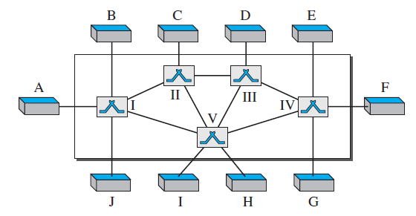

Slide 5
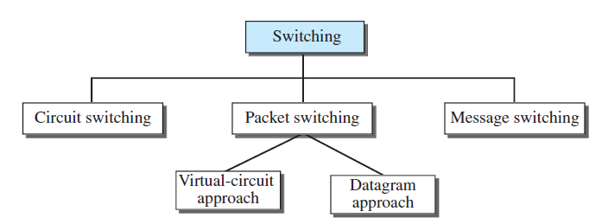

Slide 6
Switching can happen at several layers:-
Switching at Physical Layer: The switches at the physical layer allow signal to travel in one path or another.
Switching at Data-Link Layer: At the data-link layer, we can have packet switching. However, the term packet in this case means frames or cells. Packet switching at the data-link layer is normally done using a virtual-circuit approach.
Switching at Network Layer: At the network layer, we can have packet switching. In this case, either a virtual-circuit approach or a datagram approach can be used. Currently the Internet uses a datagram approach.
Switching at Application Layer: At the application layer, we can have only message switching. The communication at the application layer occurs by exchanging messages. Conceptually, we can say that communication using e-mail is a kind of message-switched communication, but we do not see any network that actually can be called a message-switched network.

Slide 7
Circuit-switched networks:-
A circuit-switched network consists of a set of switches connected by physical links. A connection between two stations is a dedicated path made of one or more links. However, each connection uses only one dedicated channel on each link. Each link is normally divided into n channels by using FDM or TDM.
Figure (2) shows a trivial circuit-switched network with four switches and four links. Each link is divided into n (n is 3 in the figure) channels by using FDM or TDM.

Slide 8
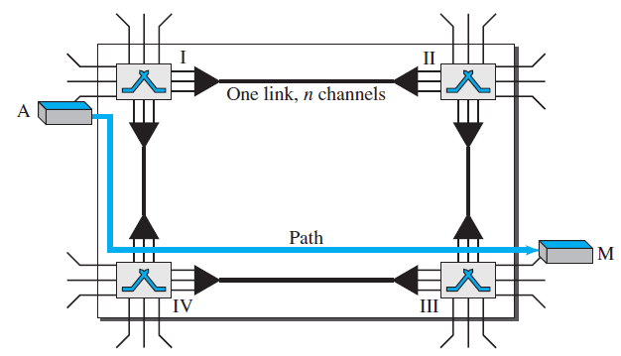

Slide 9
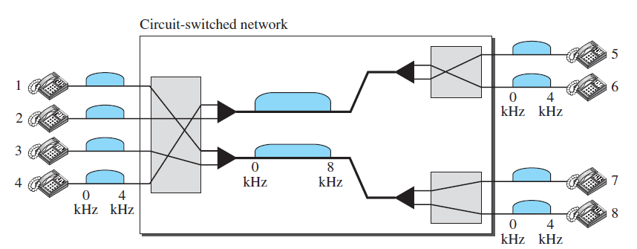

Slide 10
The actual communication in a circuit-switched network requires three phases: connection setup, data transfer, and connection teardown.
Setup Phase: - Before the two parties (or multiple parties in a conference call) can communicate, a dedicated circuit (combination of channels in links) needs to be established. The end systems are normally connected through dedicated lines to the switches, so connection setup means creating dedicated channels between the switches.
Data-Transfer Phase: - After the establishment of the dedicated circuit (channels), the two parties can transfer data.
Teardown Phase: - When one of the parties needs to disconnect, a signal is sent to each switch to release the resources.

Slide 11
